Slide 1
Bellman Optimality of Average-Reward Robust Markov Decision Processes with a Constant Gain
Shengbo Wang¹
Joint work with Nian Si²
¹Daniel J. Epstein Department of Industrial and Systems Engineering, USC
²Department of Industrial Engineering and Decision Analytics, HKUST

Slide 2
Introduction and motivation

Slide 3
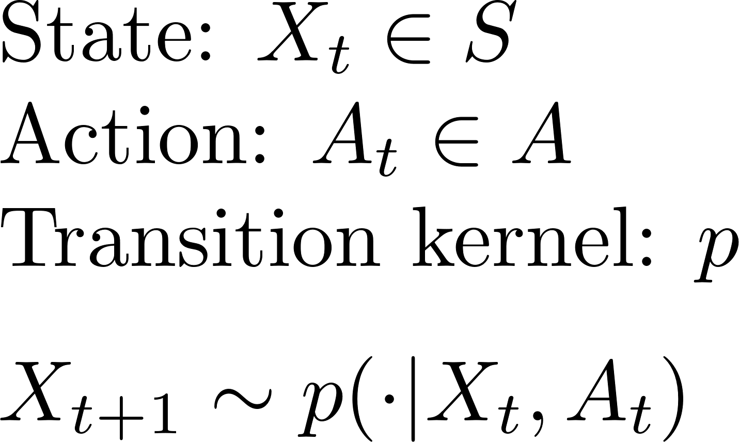
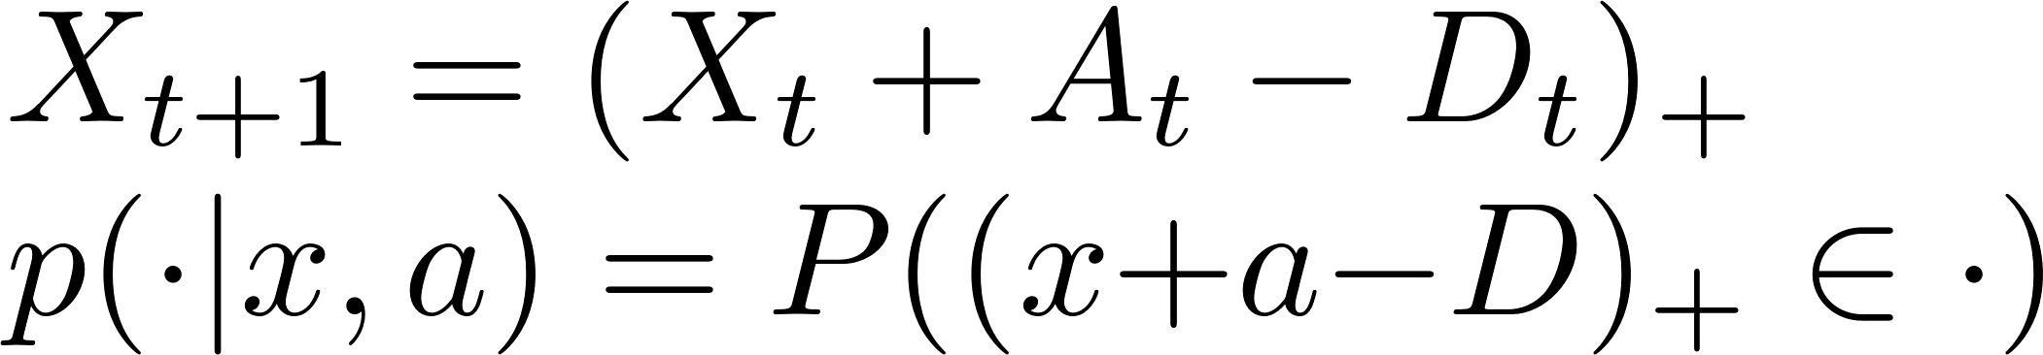

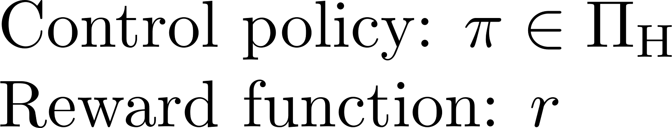
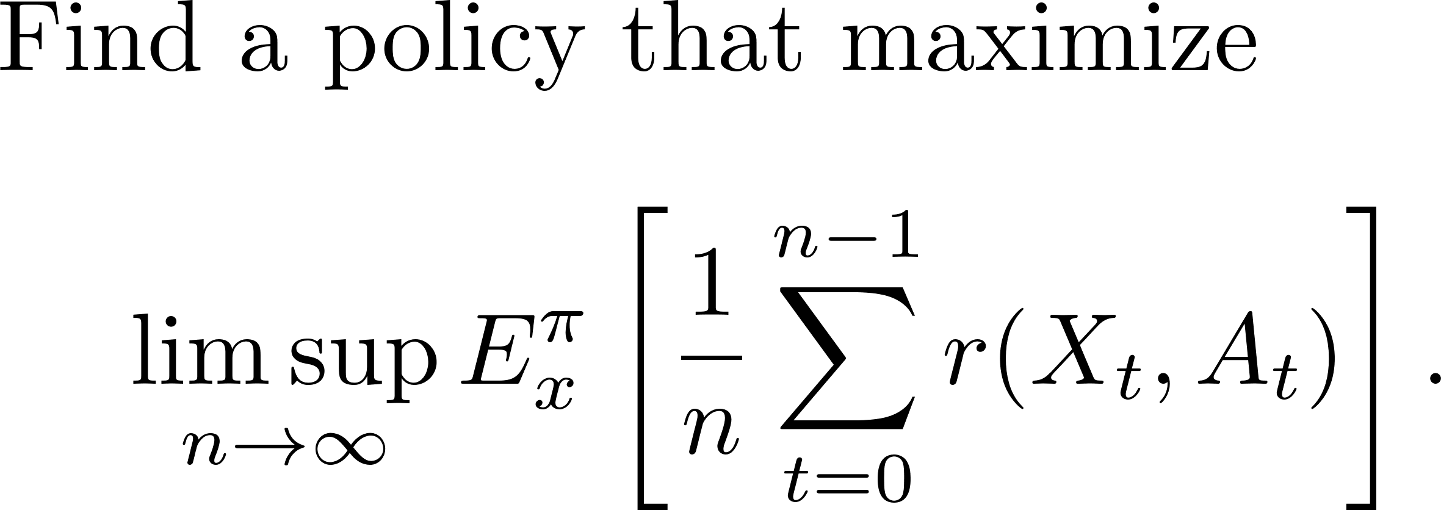
Average-Reward Markov Decision Processes

Slide 4
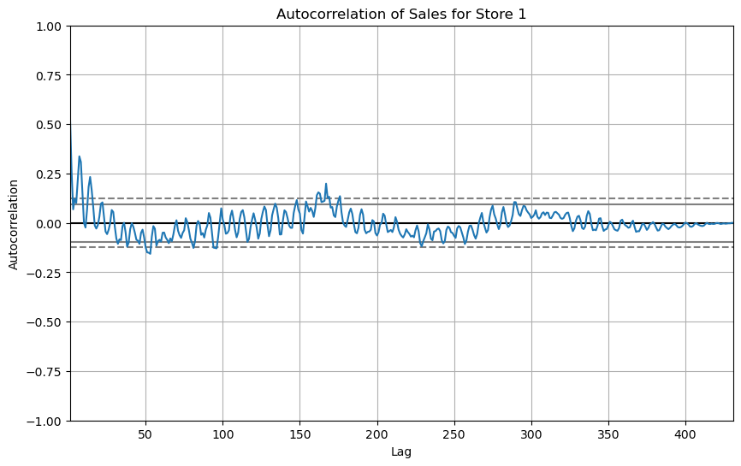
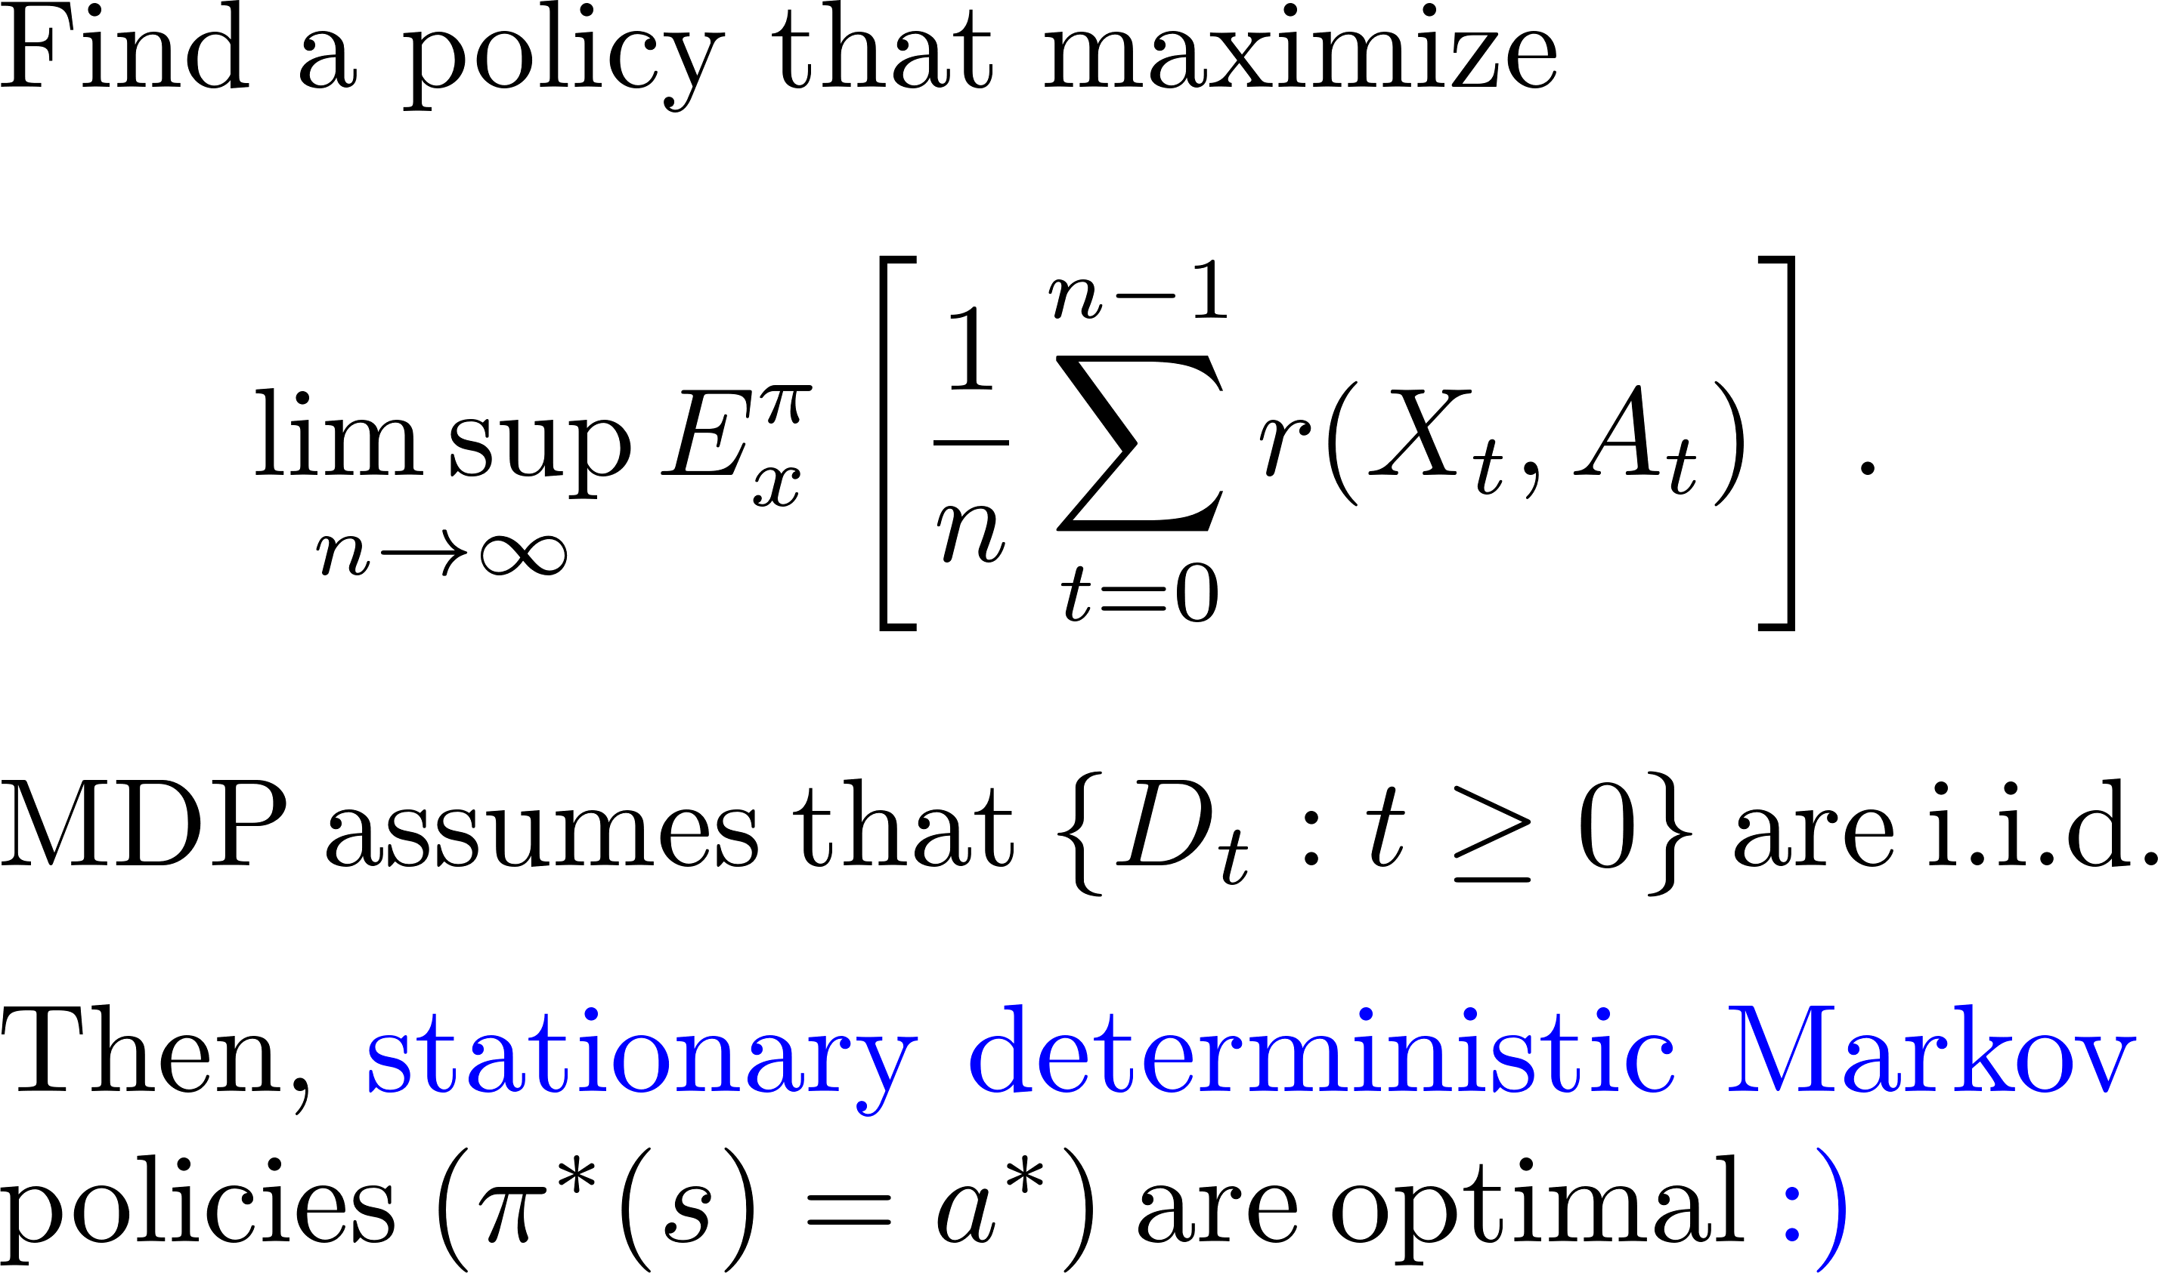
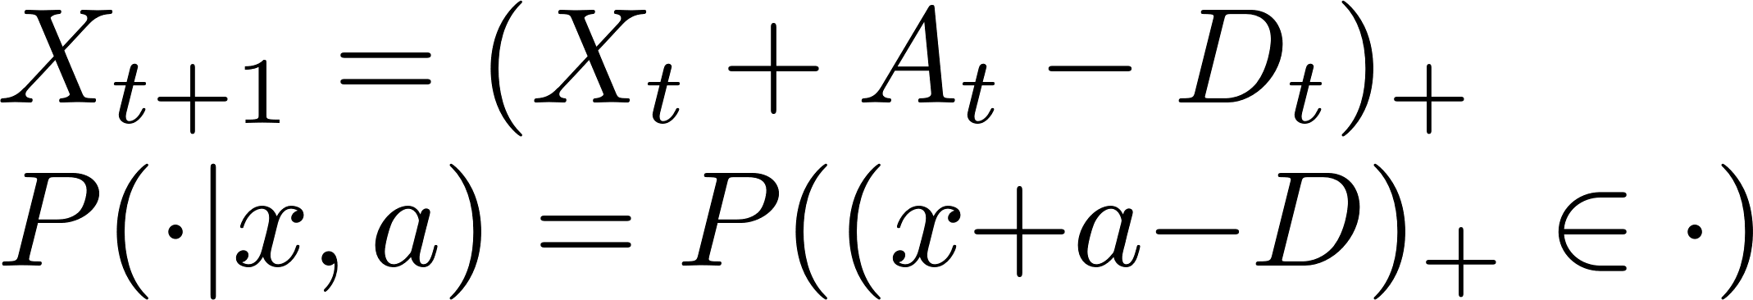
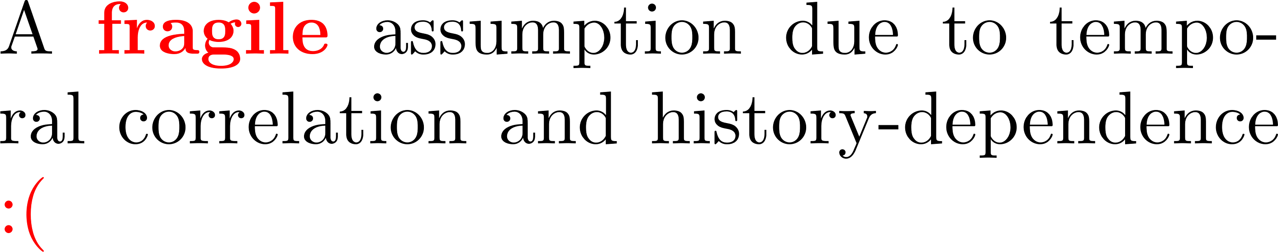
Fragility of Markovian and Homogeneity

Slide 5
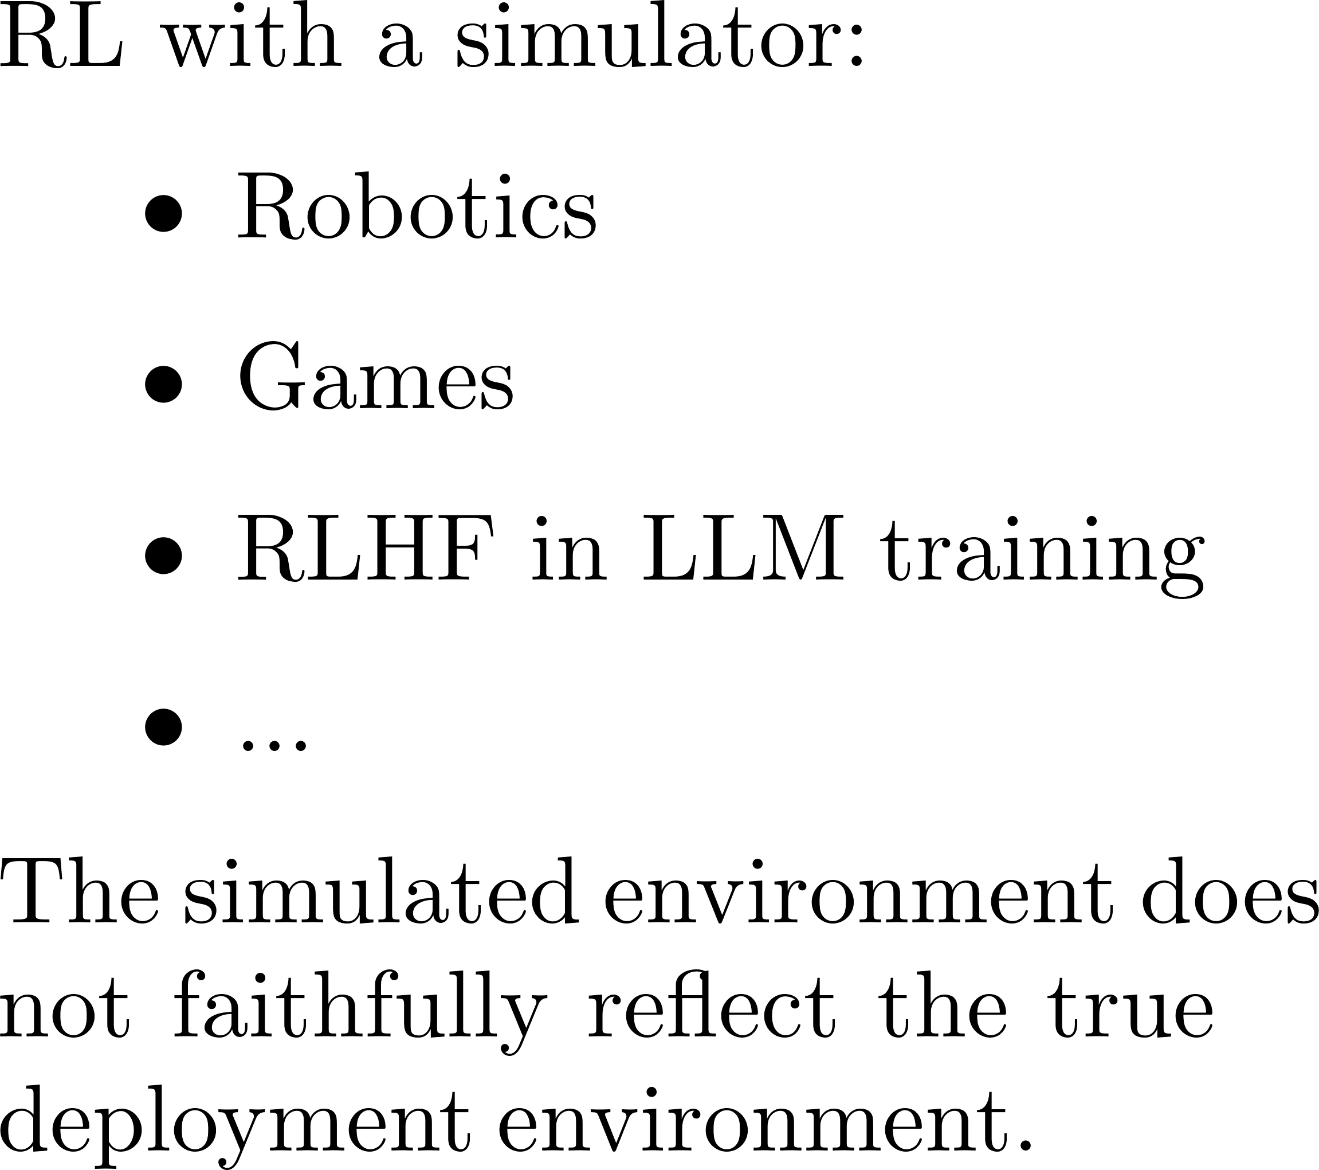

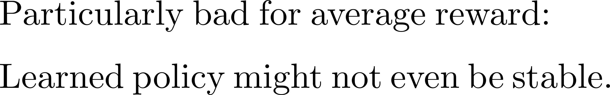
Sim-To-Real Gap
Notes:
Another huge concern of these MDP models stems from the RL community, where we train RL agents in simulated environments and deploy them in the real world.

Slide 6
Formulation and results

Slide 7
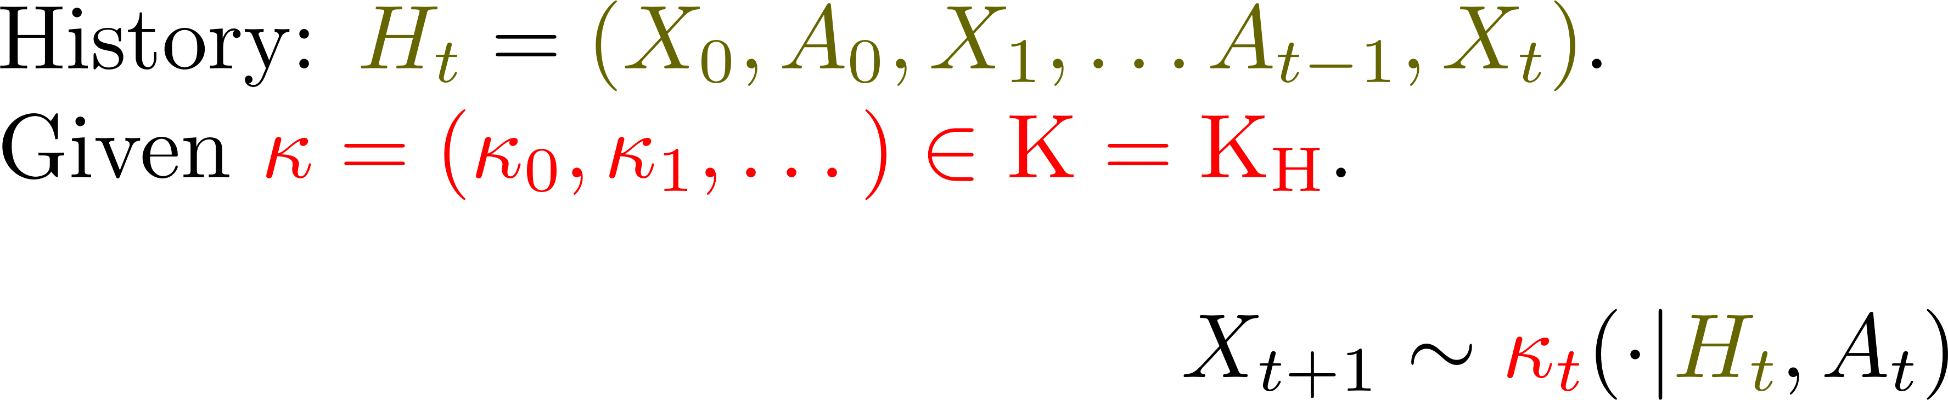
Adversarial Robustness Approach

Slide 8
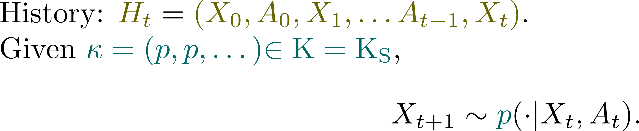
Adversarial Robustness Approach

Slide 9
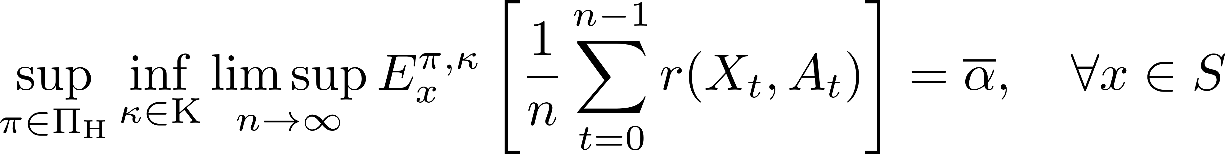
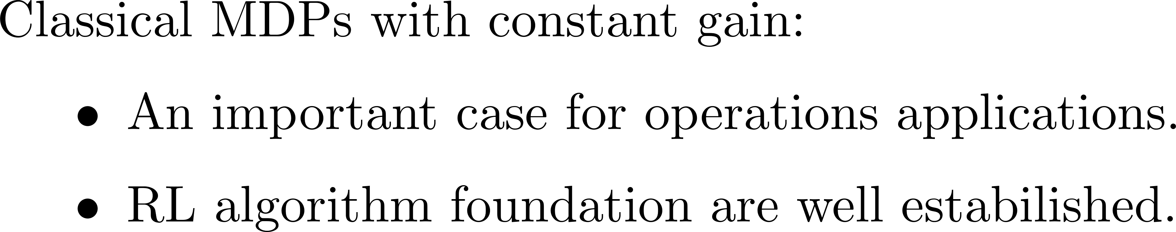
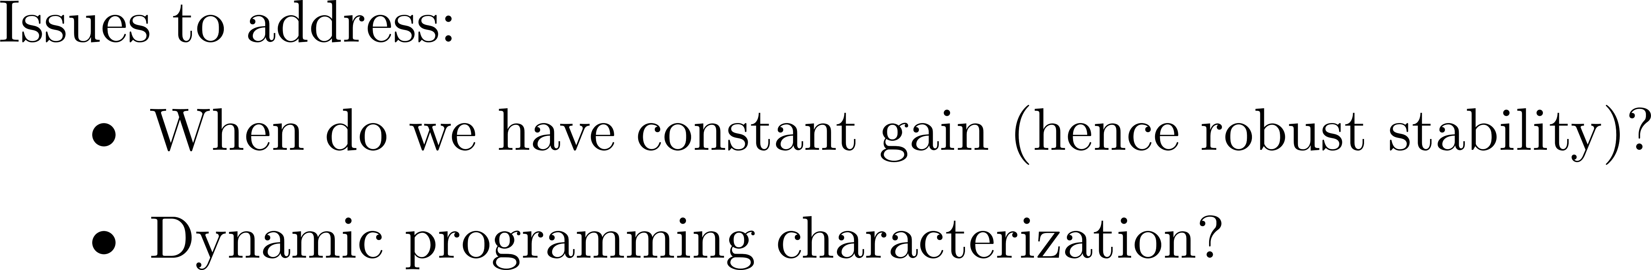
Robust MDP with a Constant Gain

Slide 10
Related Literature
Discounted robust MDP:
[Nilim and El Ghaoui 2005], [Iyengar 2005], [Xu and Mannor 2010], [Wiesemann et al. 2013],[W et al. 2024], [Li and Shapiro 2024]
Average-reward robust MDP:
[Grand-Clement et al. 2023] (General gain, negative results)
[Wang et al. 2024] (Constant gain, SA-rectangular, unichain)

Slide 11
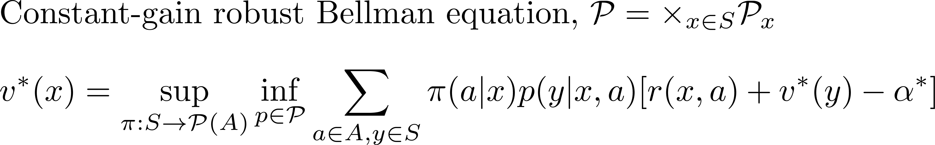
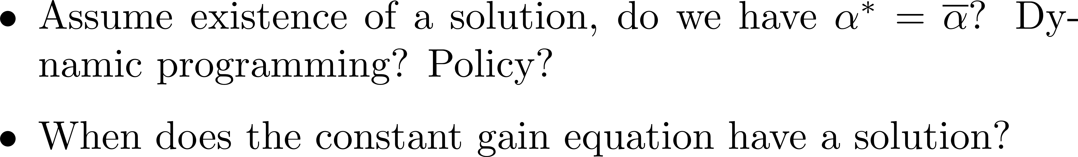
Bellman Optimality

Slide 12
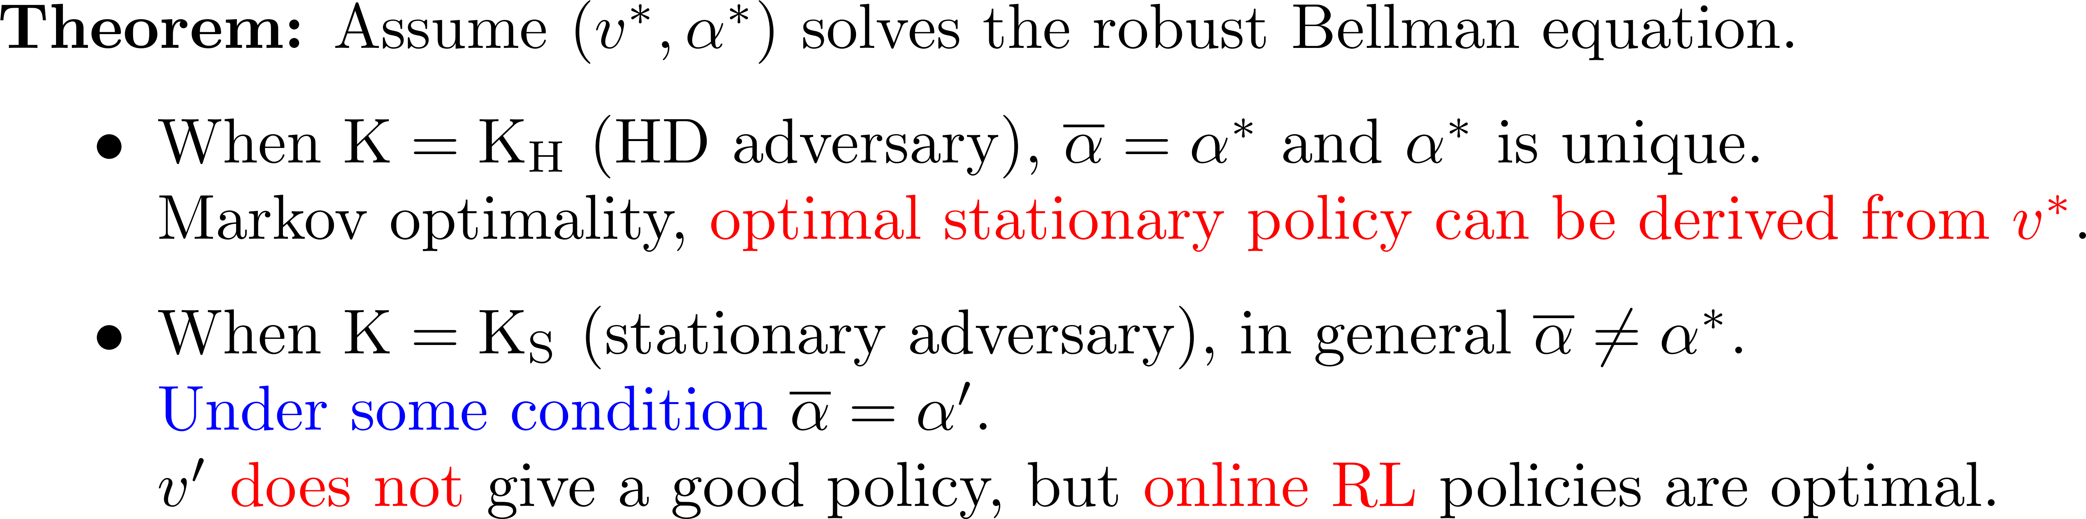
Assume a Solution to the Constant Gain Eqn

Slide 13
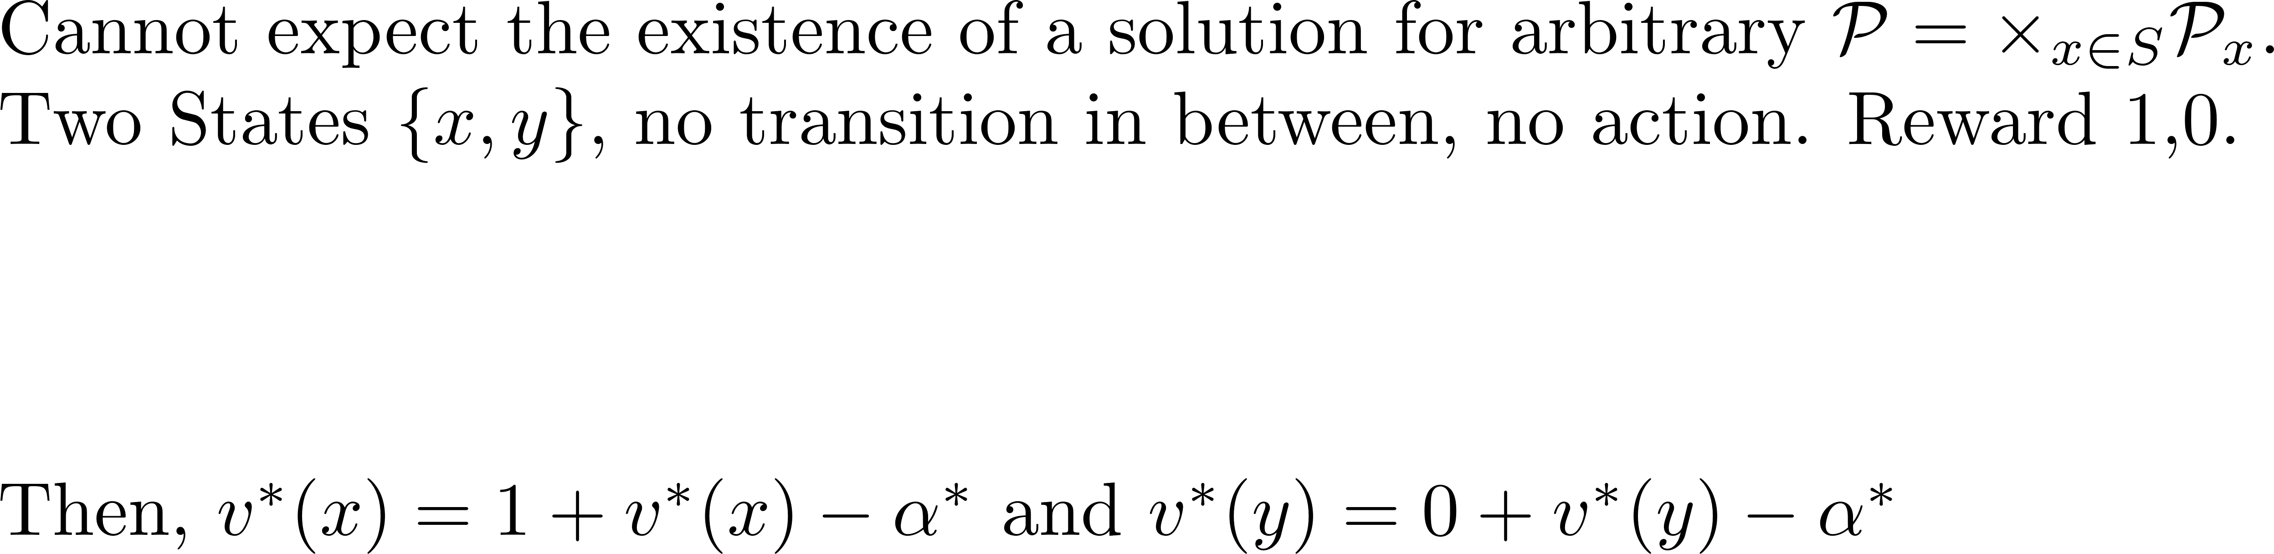
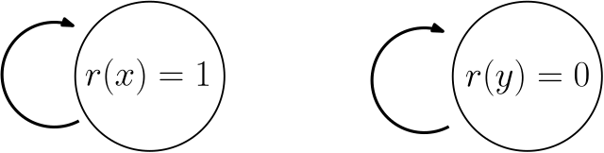
Existence of a Solution

Slide 14
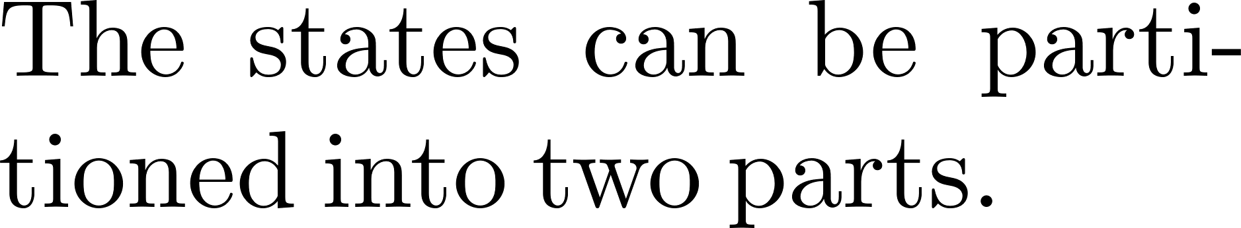
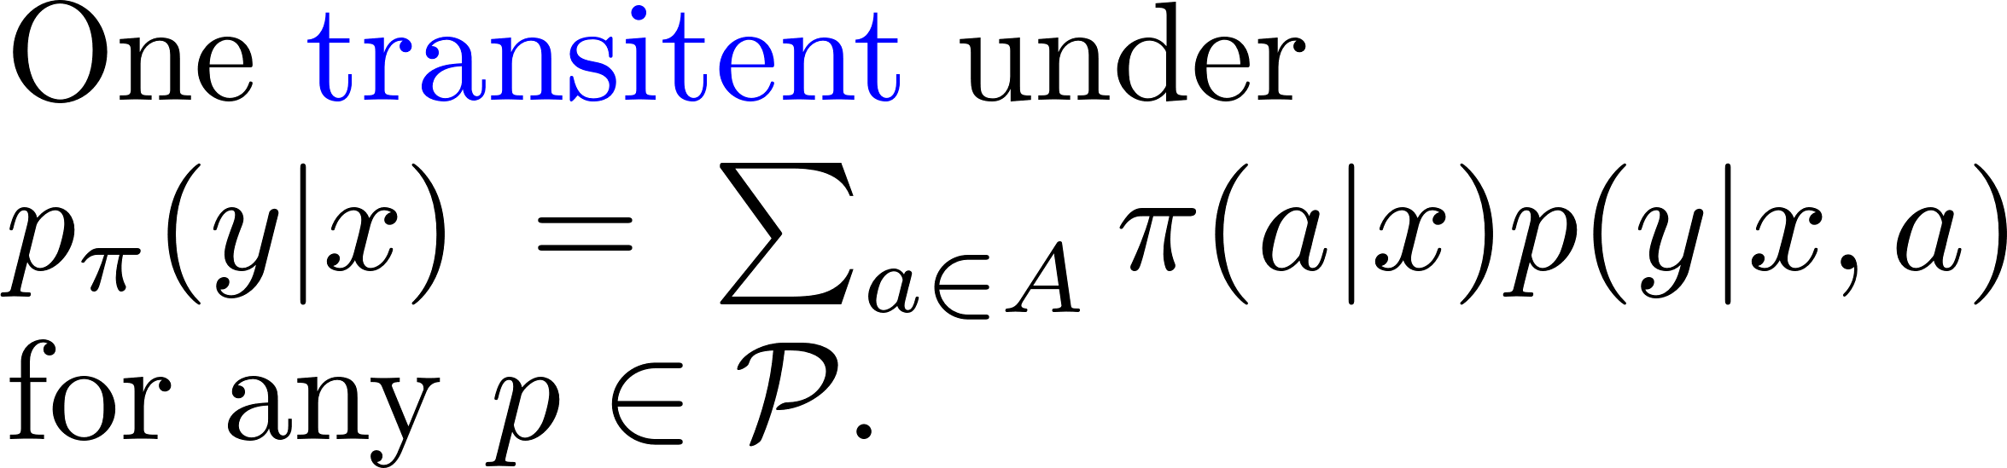
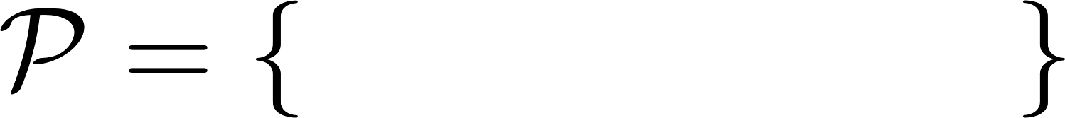
Weak Communication Structures

Slide 15
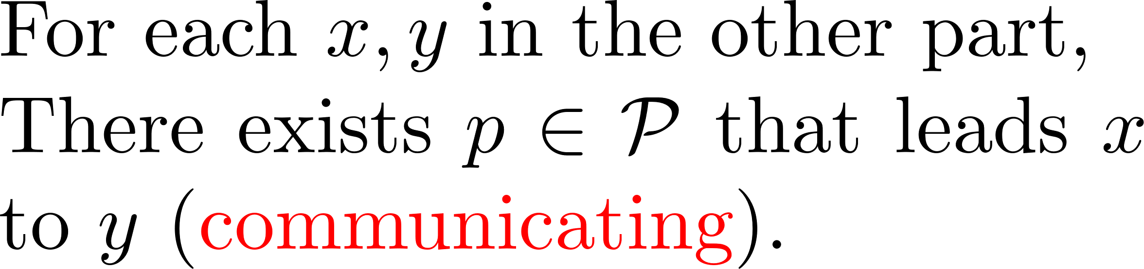
Weak Communication Structures

Slide 16
Weak Communication Structures

Slide 17
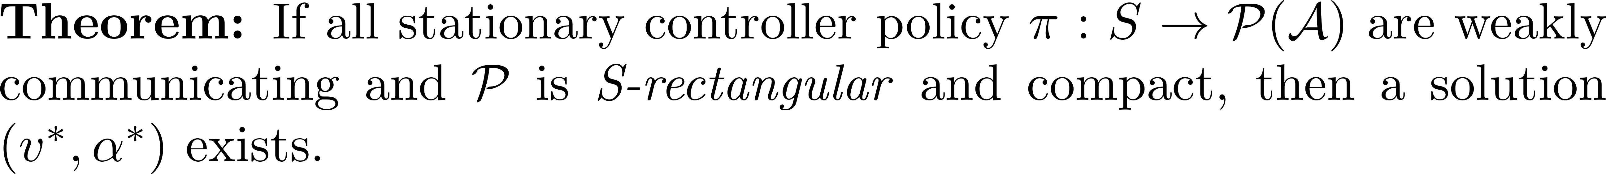
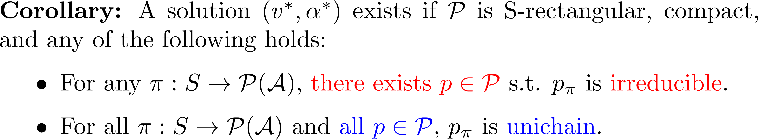
Existence of Solution: Weak Communication

Slide 18

Thank You Your questions and thoughts are most welcome!

Slide 19

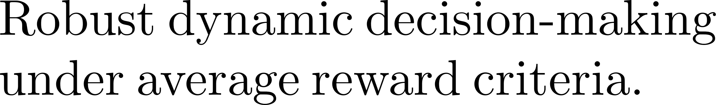

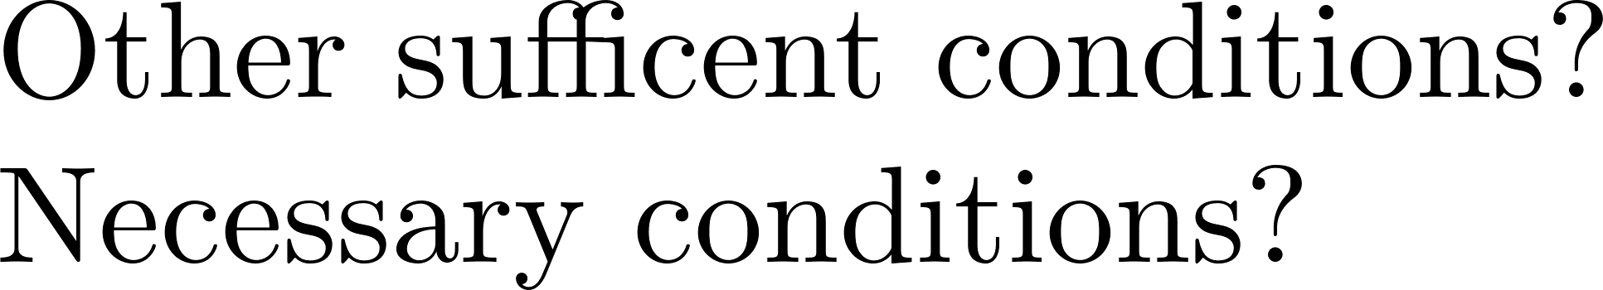
Summary of the Main Story Line

Slide 20
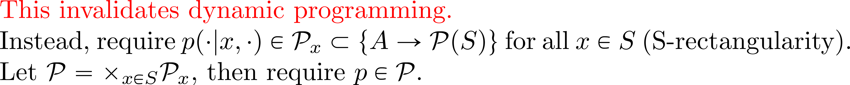
Constrained Robustness

Slide 21
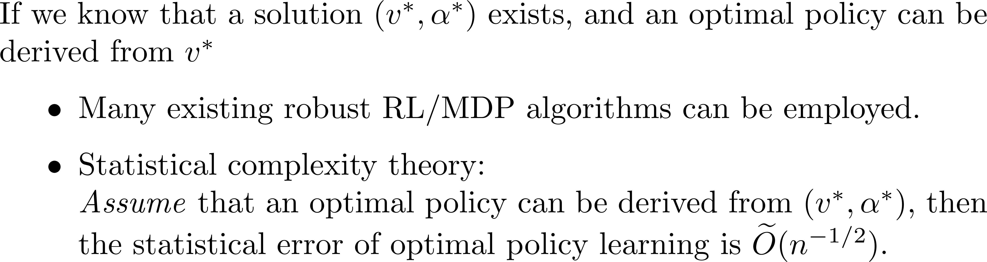
Bellman Optimality: Learning Perspective

